Slide 1
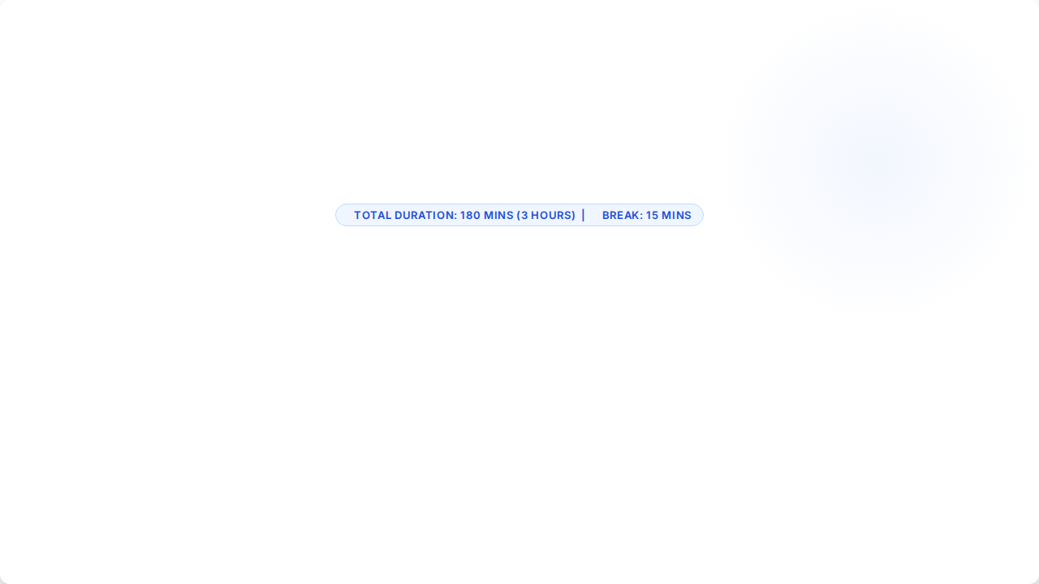
LU1: Fundamentals of Digital Business Strategy
Navigating Strategic Transformation, Digital Value Networks & Business Alignment

Slide 2

Session Schedule & Timeline
Time / Duration | Topic & Learning Focus | Activity / Delivery Mode
00:00 - 00:15 (15m) | Course Intro & Unit Learning Outcomes | Lecture & Interactive Q&A
00:15 - 00:50 (35m) | LO1: Digital Business vs. Traditional E-Commerce | Mini-Lecture (20m) + Activity 1 Case Study (15m)
00:50 - 01:25 (35m) | LO2: Linear Business Models vs. Value Networks | Concept Mapping (20m) + Activity 2 Workshop (15m)
01:25 - 01:40 (15m) | Scheduled Session Break | Networking & Refreshment Break
01:40 - 02:15 (35m) | LO3: Enterprise Transformation Drivers | Lecture (20m) + Activity 3 Matrix Analysis (15m)
02:15 - 02:50 (35m) | LO4: Alignment, Culture Change & Digital ROI | Strategy Presentation (15m) + Activity 4 ROI Exercise (20m)
02:50 - 03:00 (10m) | Summary, Wrap-Up & Key Takeaways | Class Discussion & Next Steps

Slide 3
Unit Learning Outcomes
LO1: Core Concepts & Evolution Explain the key definitions, evolution, and foundational principles of digital business vs. traditional e-commerce.
LO2: Linear vs Value Networks Analyze the core operational and strategic differences between traditional linear business models and digital value networks.
LO3: Enterprise Drivers Identify key market, technological, and customer drivers behind enterprise digital transformation.
LO4: Alignment, Change & ROI Evaluate methods to align digital initiatives with overarching business goals while managing organizational change and performance ROI.

Slide 4

LO1: Digital Business Concepts
Definitions, Evolution, and Foundational Strategic Principles

Slide 5


Digital Business vs E-Commerce
Traditional E-Commerce
Holistic Digital Business
Primary Focus: Transactional activities focused on buying and selling goods/services online.
Primary Focus: End-to-end organizational transformation leveraging modern tech stack.
Scope: Outward-facing revenue channel, customer portals, and payment gateway integration.
Scope: Integrates internal operations, supply chains, partner ecosystems, and customer touchpoints.
Value Creation: Digital storefront facilitating electronic trade and automated sales.
Value Creation: Platform-driven capabilities, data monetization, and agile business models.

Slide 6

Evolution of Digital Strategy
From Websites to Ecosystems
The progression of enterprise technology spans three distinct strategic eras:
1. Web Presence (1990s): Basic information sharing and brochureware.
2. E-Commerce Era (2000s): Online transactions, CRM integration, and digital marketing.
3. Digital Business (Present): Platform models, AI automation, cloud systems, and dynamic value ecosystems.

Slide 7






LO1 Activity: Case Study
Objective: Evaluate a traditional retail enterprise transitioning to a digital business ecosystem.
1. Identify (4 Mins)
2. Brainstorm (6 Mins)
3. Share (5 Mins)
Analyze Company X's current model. List 3 functions that are purely e-commerce vs. 3 that reflect a digital business approach.
Propose 2 new digital business capabilities (e.g., IoT data monetization, automated partner API integration).
Each group presents 1 key differentiator between their proposed digital business strategy and simple online selling.

Slide 8
LO2: Digital Value Networks
Analyzing Operational and Strategic Shift from Linear Supply Chains to Ecosystems

Slide 9
Linear Models vs Value Networks
Strategic Dimension | Traditional Linear Model | Digital Value Network
Structure | Sequential value chain (Supplier → Producer → Distributor → Buyer) | Multi-directional matrix & platform ecosystems
Customer Role | Passive consumer at the end of the supply chain | Active co-creator, data source, and ecosystem participant
Data Flow | Siloed, batch-processed, delayed feedback loops | Real-time, continuous cloud data exchange across network
Scalability | Linear scale tied heavily to physical assets & capital | Exponential scale driven by network effects and software

Slide 10
LO2 Activity: Network Mapping
Objective: Re-engineer a linear business supply chain into a multi-directional digital value network.
1. Map Linear Chain (4 Mins)
2. Design Network (6 Mins)
3. Evaluate Value (5 Mins)
Sketch the standard linear flow for a traditional industry (e.g., Automotive, Healthcare, or Logistics).
Add data nodes, platform partners, third-party developers, and feedback loops into a network mesh.
Identify where new network effects create exponential value compared to the old linear model.

Slide 11
LO3: Transformation Drivers
Market, Technological, and Customer Forces Shaping Digital Business

Slide 12






Core Drivers of Change
Market Drivers
Tech Drivers
Customer Drivers
New digital entrants, industry disruption, shifting economic pressures, and the imperative for speed-to-market agility.
Rapid advancement of Cloud Computing, Artificial Intelligence, Big Data Analytics, and IoT infrastructure.
Demand for hyper-personalized experiences, omnichannel access, instant fulfillment, and transparent interactions.

Slide 13
LO3 Activity: Driver Analysis
Objective: Rank and categorize external transformation drivers for a selected industry scenario.
1. Categorize (4 Mins)
2. Prioritize (6 Mins)
3. Present (5 Mins)
List the top 2 Market, Tech, and Customer drivers affecting your assigned industry sector.
Plot drivers on an Impact vs. Urgency matrix to determine immediate strategic focus areas.
Defend your #1 driver selection and explain why failing to adapt creates competitive risk.

Slide 14
LO4: Alignment, Change & ROI
Executing Digital Strategy, Managing Culture, and Quantifying Financial Value

Slide 15



Strategic Alignment & ROI
Organizational & Goal Alignment
Evaluating Performance & ROI
Strategic Mapping: Connect digital KPIs directly to enterprise revenue, cost reduction, and market share goals.
Multi-Metric Framework: Measure short-term operational efficiency alongside long-term strategic value and enterprise agility.
Change Management: Address cultural resistance through continuous upskilling, clear communication, and leadership advocacy.

Slide 16

LO4 Activity: ROI Strategy
Digital Business Case & Change Plan
Task 1 (8 Mins): Calculate expected Digital ROI for a $500k cloud transformation producing $1.2M in cumulative efficiency gains.
Task 2 (7 Mins): Outline a 3-step cultural change program to overcome staff resistance to new automated AI workflows.
Task 3 (5 Mins): Present proposed alignment metrics to the executive board.

Slide 17
Questions & Discussion
End of LU1: Fundamentals of Digital Business Strategy (180 Mins Completed)
Next: LU2 – Strategic Framework for Digital Age

Slide 18


Image Sources
https://cf-images.us-east-1.prod.boltdns.net/v1/static/6415937670001/09067fad-7d40-4adf-b129-5cf51c9beb35/84d26e1b-e8dd-433b-baf7-80919eae6847/1920x1080/match/image.jpg
Source: corporate.exxonmobil.com
https://get.pxhere.com/photo/discussion-diverse-entrepreneur-european-expertise-expression-financial-group-hands-laptop-man-meeting-network-notebook-people-presentation-startup-strategy-talking-team-teamwork-together-training-vision-westerner-wireless-woman-work-working-workplace-workshop-workspace-communication-collaboration-electronic-device-institution-technology-conversation-public-relations-human-behavior-job-business-business-administration-management-1433625.jpg
Source: pxhere.com

